Slide 1
ConnectBud
Python
Class 5
By: Rahul Joshi

Slide 2
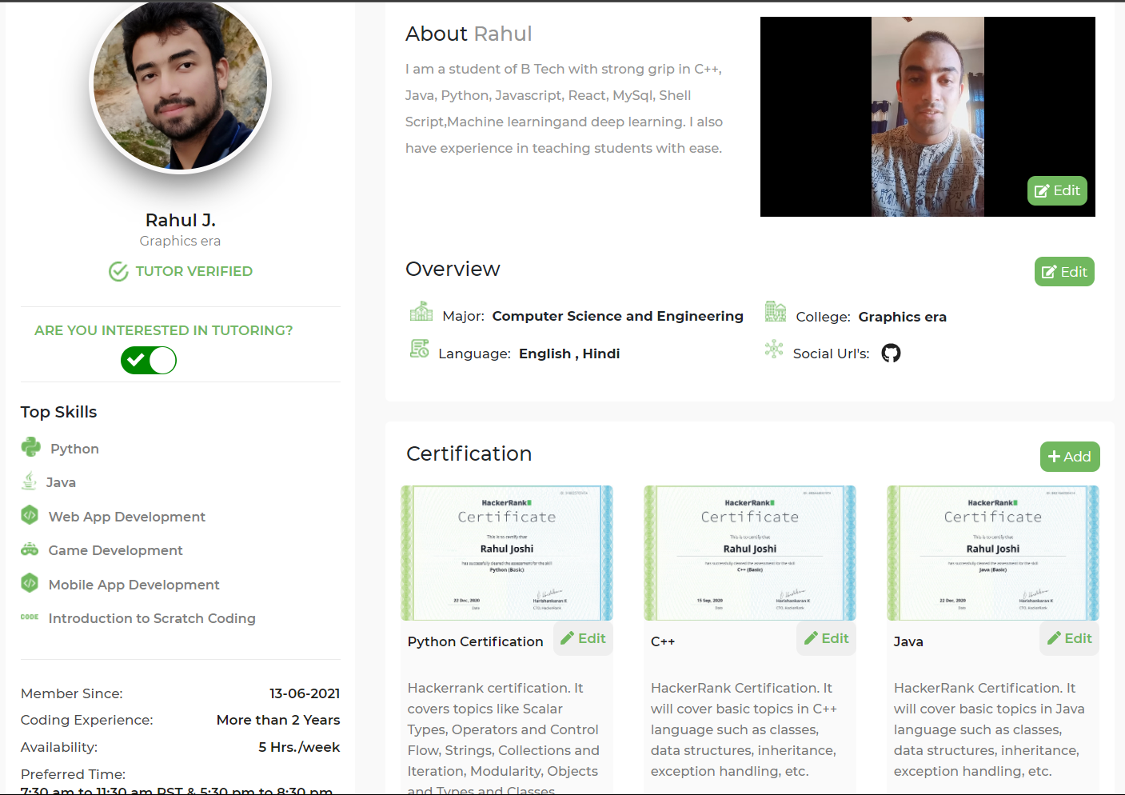

Slide 3
Day 5 H.W.
age=int(input("Insert the age"))
print("Age : ",age)
print(type(age))
percentage=float(input("Insert the percentage"))
print("Percentage : ",percentage)
print(type(percentage))

Slide 4
Class Overview
Class 4: • Input and Output.

Slide 5
Syntax
C1=input()

Slide 6
Example
print("Enter your details")
print("Provide your Name")
name=input()
print("Insert your age")
age=input()
print("Where do you study")
school=input()
print("Details:")
print("Name : ",name)
print("Age : ",age)
print("School : ",school)

Slide 7
Eg
name=input("enter your name : ")
print("Name inserted =" , name)
age=int(input("Enter your age"))
print("Age : ",age)
print(type(name))
print(type(age))
Print(type(11.5))
Age=int(input(“Enter your age”))
Print(“Enter your age”)
Wait for user to provide the input
User writes something
Int(string):
Convert the string to integer.
Value gets stored insode the container.

Slide 8
Task
Input two integer from user
Print out those integers
Input float variable
print out the float value.

Slide 9
End
For any queries: Contact:
Rahul Joshi rj26280218@gmail.com

